Slide 1

TRAVEL MANAGEMENT SYSTEM
Team members:
Kaustubh Mishra(8956)
Vivan Stanislaus(8974)
Mitesh Jaiman(8946)
Group 13

Slide 2
Tourism can be considered as the most favorite pastime. Several travel organizations are available on the web. The people or the tourist select their own Travel Package according to their personal interest.
Online Travel Management system is an application that allows travelers to check for flight tickets availability, book a ticket. The traditional method of travel management system is presently in use which involves the use of papers for storing traveller’s information, with this method there is always a long queue, loss of data, incomplete traveller’s information and inaccuracy. An online Travel management system was implemented for accurate and profitable data management.
INTRODUCTION

Slide 3
Selection of Problem Statement:
The definition of our problem lies in the manual system and a fully automated system.
Existing System: The system is very time consuming and lazy. This system is more prone to errors and sometimes the approach to various problems is unstructured.
Proposed System: With the advent of latest technology if we do not update our system then our business results in losses gradually with time. The technical systems contain the tools of the latest trend i.e. computers printers, fax, Internet etc. The systems with this technology are very fast, accurate, user-friendly and reliable.

Slide 4
Definition of Problem Statement
:
Travelers can search and book travel ( flights)
Pricing will be individualized based on customer preferences
Suppliers can upload inventory(airlines) .
It includes the following Actor-wise functionalities.

Slide 5
Traveler:
● Can Signup and Signin.
● Search and Book Travel.
● View recently booked ticket.
Inventory Supplier:
● Can Signup and Signin.
● Can upload inventory for Travelers.
Actor-wise Functionalities:
Rating:
● Ratings option will be given after successful Booking.
Ticket Generation:
● Tickets will be printed with the Price based on Customer preferences
Manager(Admin):
● Has the authority to control the entire application.
● Can manage data.

Slide 6
❖ Operating System: Platform Independent
❖ ​Concept Used:
★ Java and Swings
★ MySQL Database
❖ Development environment/tools: INTELLIJ IDEA and WampServer.
System Requirement:

Slide 7
UML Diagrams

Slide 8
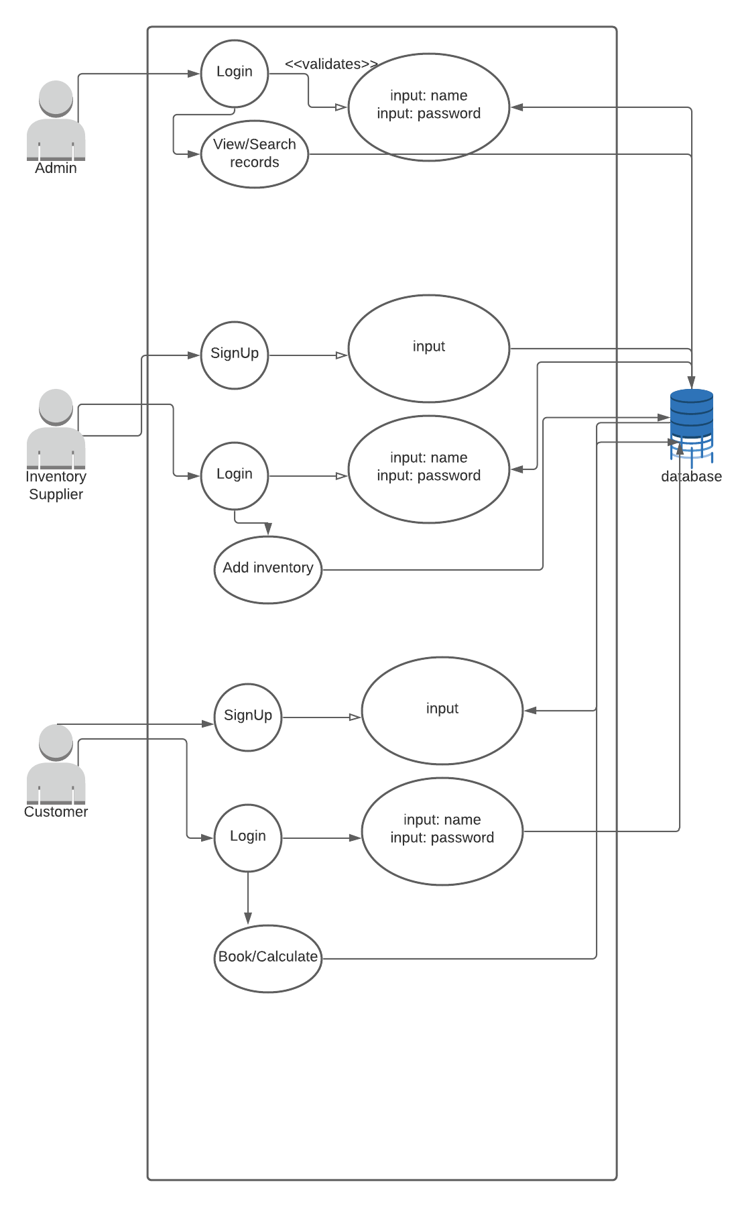

Slide 10
GUI Design

Slide 11
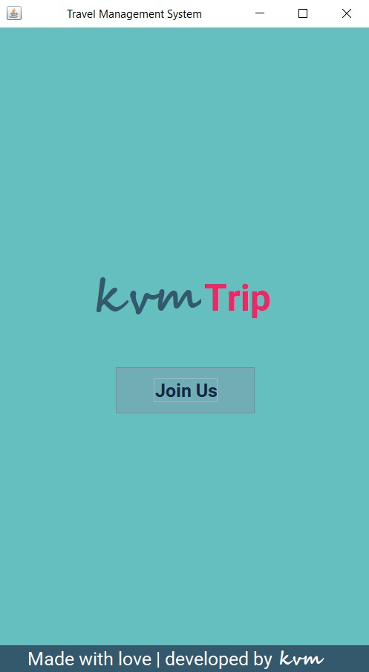
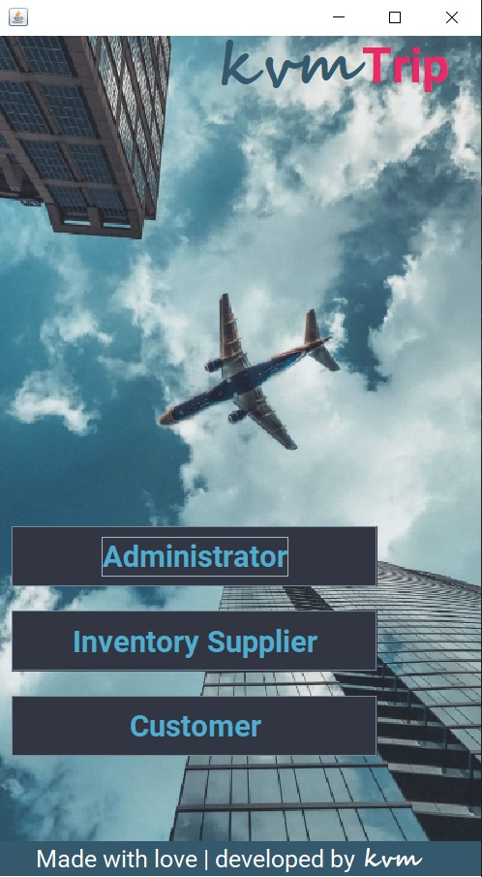
Home Page

Slide 12
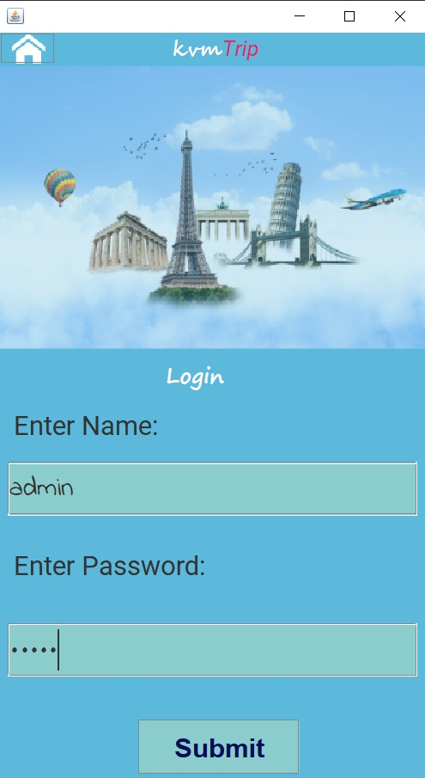
Admin login

Slide 13
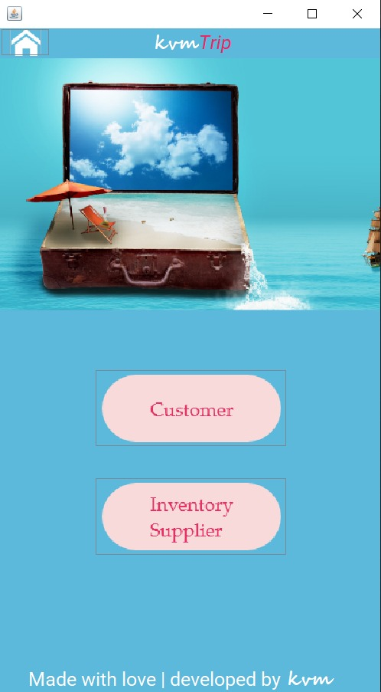
Admin Dashboard

Slide 14
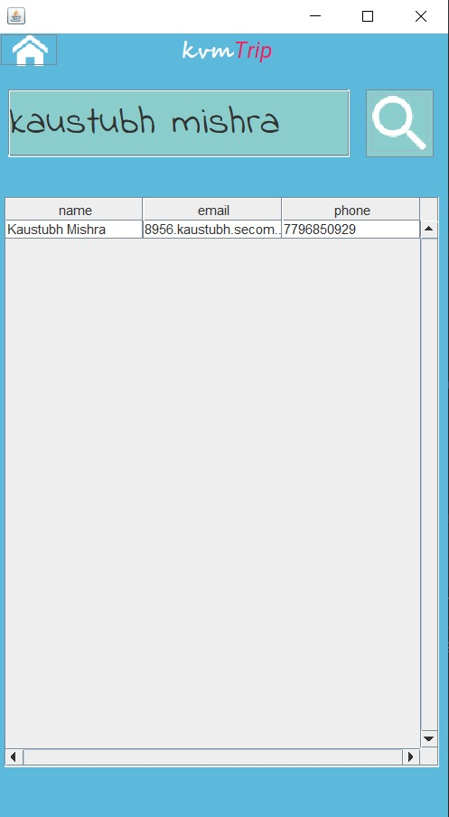
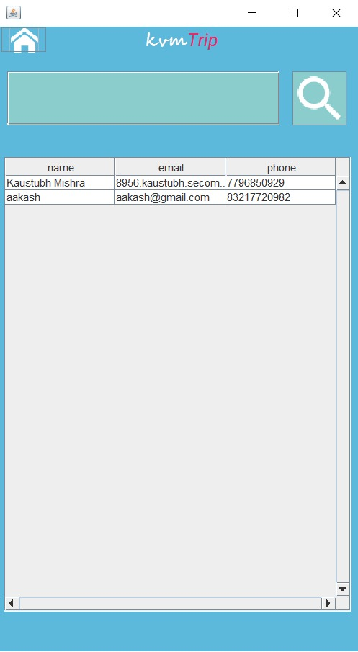
Has the authority to View & Search both Customer and Inventory supplier Information

Slide 15
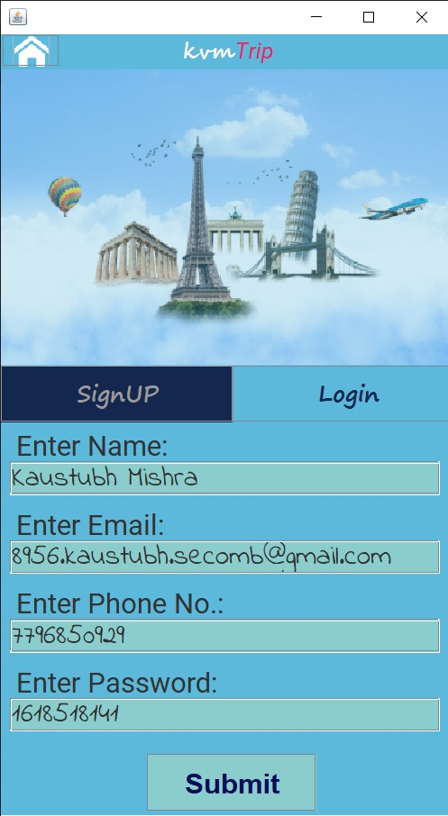
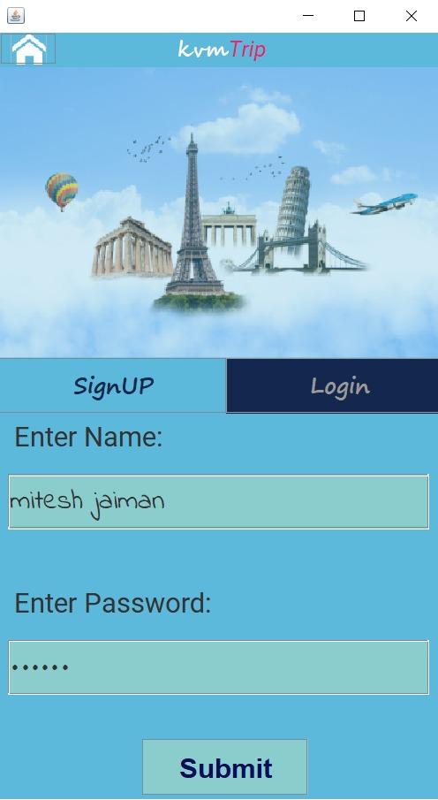
Inventory Supplier and customers Login & SignUP

Slide 16
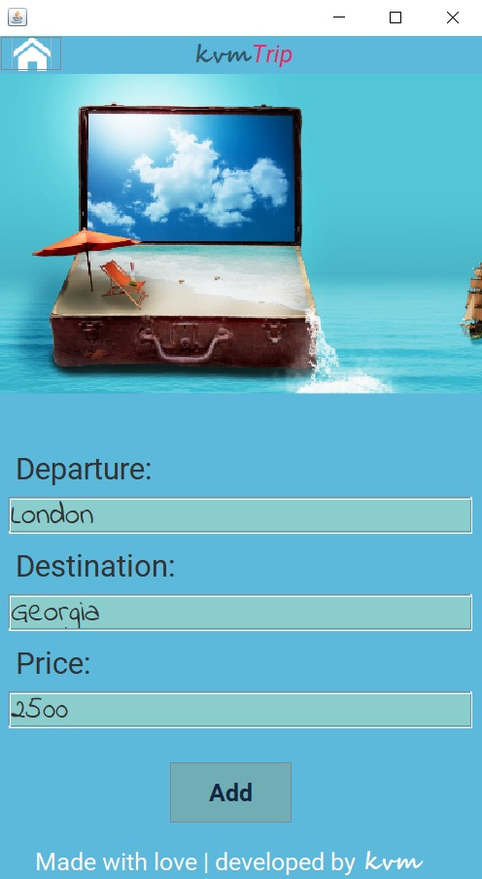
Suppliers inventory

Slide 17
Flight booking process

Slide 18
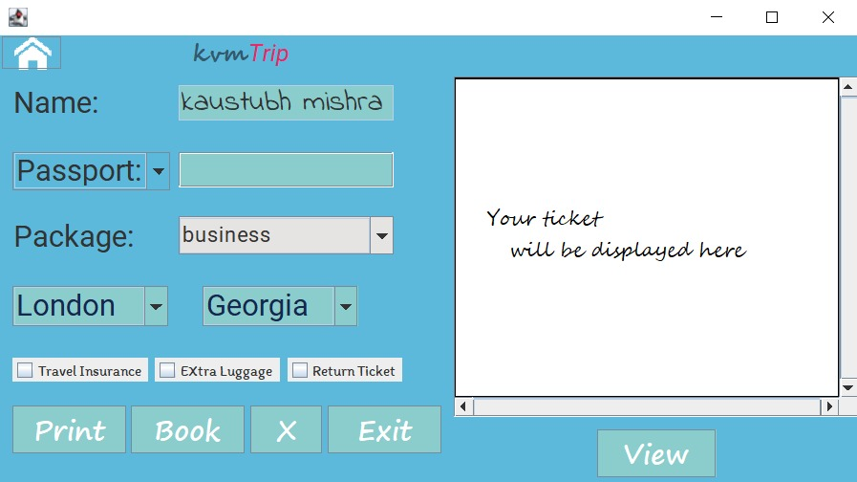

Slide 19
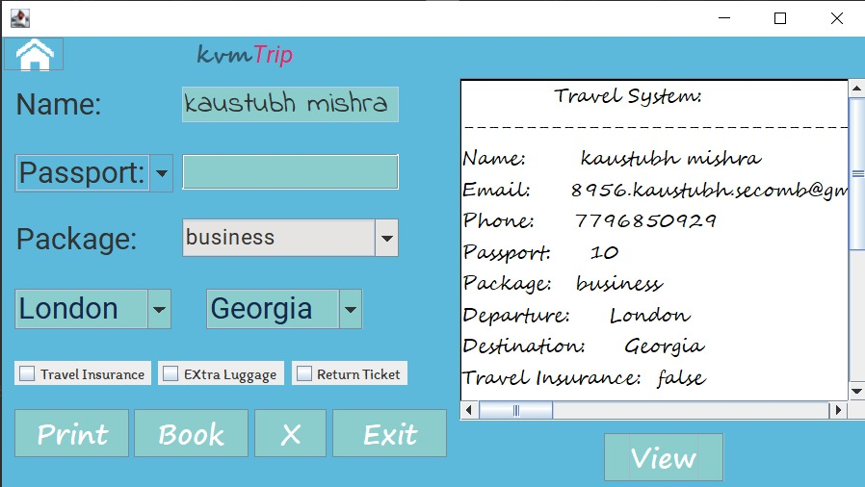

Slide 20
Database table

Slide 21
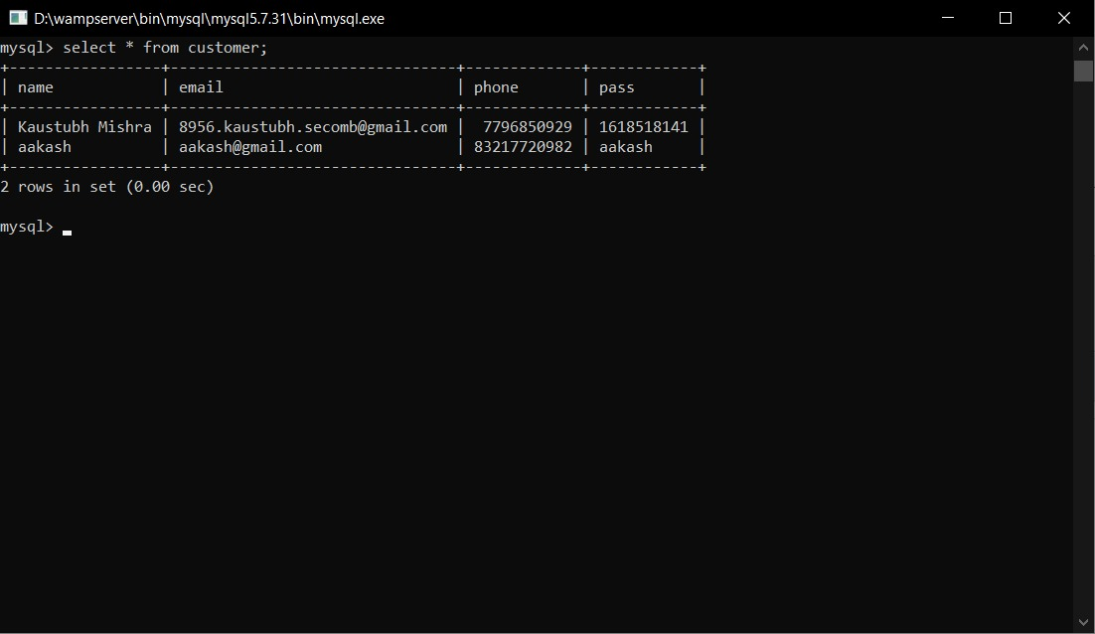

Slide 22
References
https://www.planttext.com/
https://www.codejava.net/
https://www.javatpoint.com/
https://www.lucidchart.com/

Slide 23

THANK YOU!

